Slide 1
Introduction to software testing
T-level

Slide 2
today
Investigate the need for software testing
Investigate test plans
Use of appropriate test data

Slide 3
Previously
We looked at design documentation
Client brief
Requirements
Pseudocode
Flowcharts
Why are these so important?

Slide 4
Previously
We looked at design documentation
Client brief
Requirements
Pseudocode
Flowcharts
Why are these so important?
To layout the functions, procedures, flow and logic of a program in a non-language specific format

Slide 5
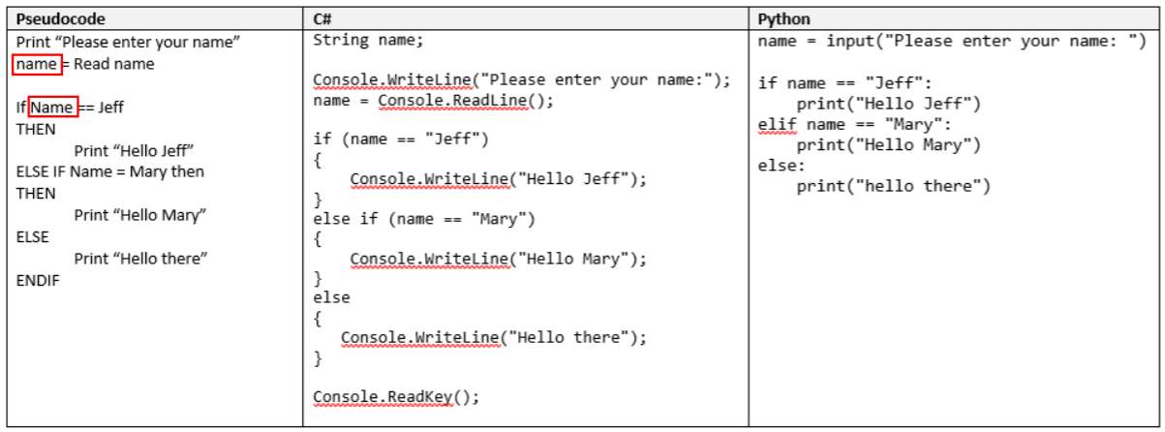
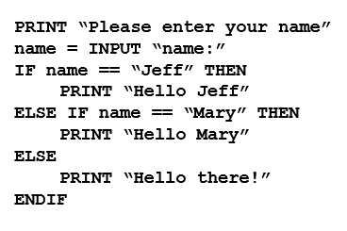
Pseudocode Example
The logic of a program in a non-language specific format
(language agnostic)

Slide 6
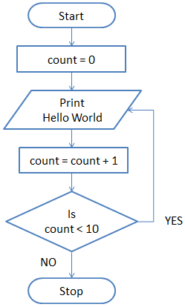

Slide 7
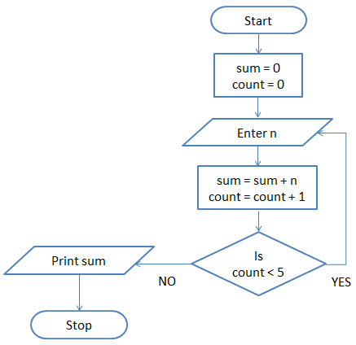

Slide 8
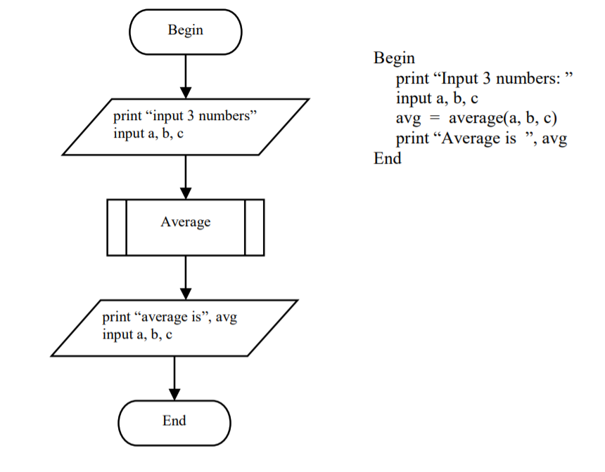
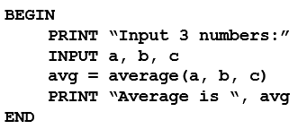
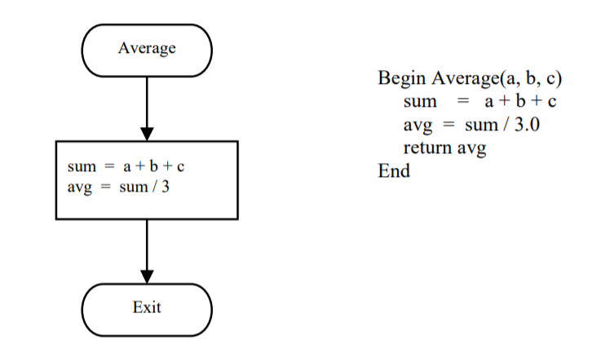
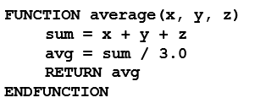

Slide 9
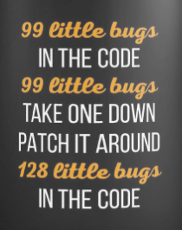

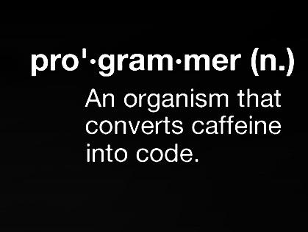
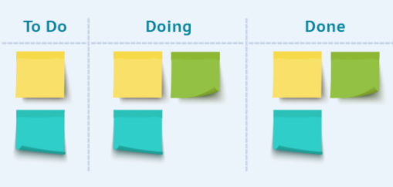
Implementation
In this stage of the project
The team create the code
It takes a lot of cups of tea and many biscuits

Slide 10
Why test software?
When you purchase a product from a shop, you expect it works as it should.
You expect it to have been fully tested prior to release.
The product should be fit for purpose
The same should be true of software

Slide 11

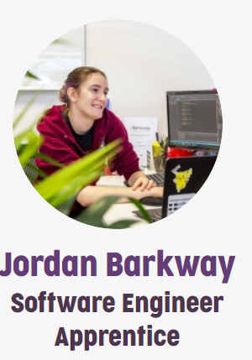
Commercial programs
Once a software product has been designed and developed…
…it must be fully tested to ensure that it does what it is supposed to do.
There is a whole profession/career based around being a software tester.

Slide 12
Testing for this task
The testing requirements for this task are quite straightforward.
We are looking at basic specification testing –
Does the program perform the job(s) that was laid out in the specification?
The next year will look in to testing in more detail, and cover:
White box testing
Black box testing

Slide 13

Specification (requirements) testing
When faced with a client brief, a set of user requirements (or specification) must be produced.
Things the dragon want are:
Width
Depth
Height
Salad bar (confirm it is there)
LGBTQIA+ (does it conform)

Slide 14
User Requirements (specification)
Accept integers from a user via keyboard entry / chat entry
Check that they are valid, consider minus numbers, very big numbers, etc
Print an appropriate message to screen stating that the robot is working
Any optional things? E.g. a moat or windows etc.

Slide 15
Requirements testing
Once you have created a list of requirements (the specification)…
…you can design and develop a program suitable of satisfying each requirement
Once the program has been developed…
…you can create a set of specification tests
These tests make up a testing plan…

Slide 16
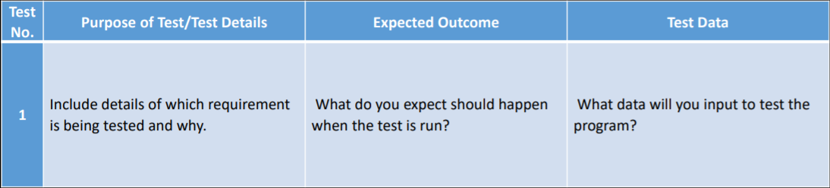
Testing plan (layout)

Slide 17
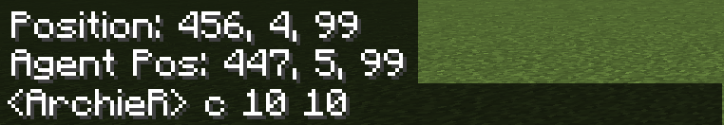
example
Test No. | Purpose of Test/Test Details | Expected Outcome | Test Data
1 | Check the program will accept valid inputs | No errors | Castle 20 20
2 | Program rejects very big width | Error message | Castle 20000 10
3 | Program rejects very big depth | Error message | Castle 10 20000
4 | Castle has windows | Castle has 3 windows | Castle 20 20
5 | Castle has moat | Castle has moat of lava | Castle 20 30
Example castle parameters
Assumed requirements

Slide 18
Carrying out the test plan
Once a thorough testing plan has been developed…
…every test must be performed.
For each test you need to document – with evidence – the actual outcome by completing a test log…

Slide 19
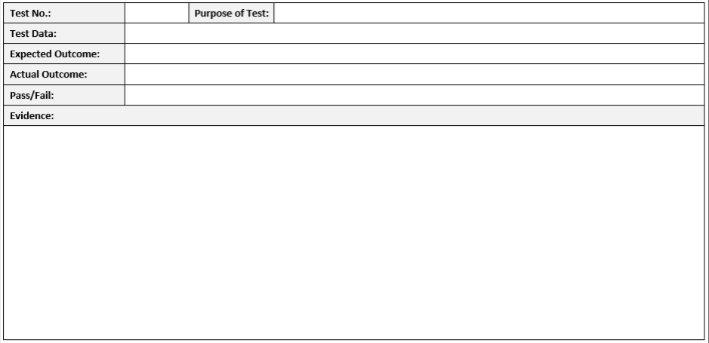
Test log

Slide 20
Test log
Pass in green
Fail in red

Slide 21
Summary of testing
Once all tests have been completed you should summarise your findings.
Then complete a revision log.
The revision log should list any changes that need to be made to fix any failed test
You must then make the changes and re-run the test.
Evidence of the re-run test should be recorded in a log to show the problem has been fixed.

Slide 22
Important!!
You should only be testing to the user requirements.
In our example, error trapping is not part of the user requirements, so…
…this should not be tested.
Only formulate tests for the specification.

